Slide 1
Network and Naming Conventions
TIGERRISK PARTNERS

Slide 2
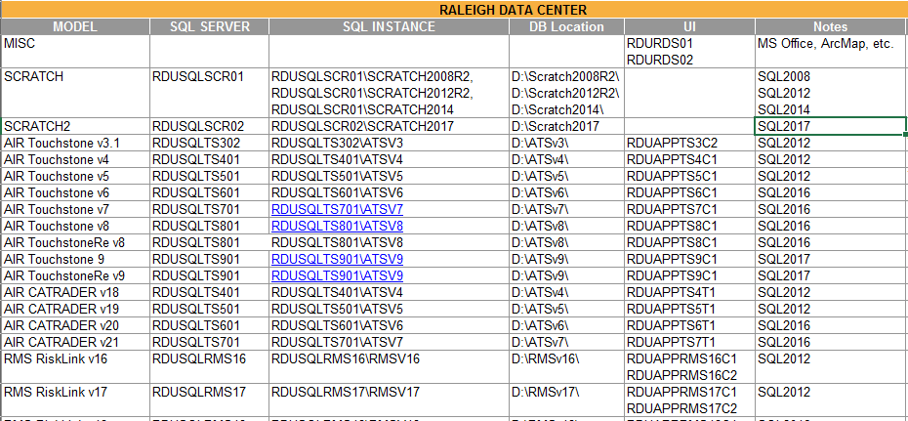
Key Network Locations
Main Network Drives
Key Model Locations R:\01_REFERENCES\00_TIGER_MODELING_SERVERS.xlsx
Contains references to current model environments and backup/archive locations
Server Names, SQL Instance, SQL Version, etc.
Drive | Description
P: | Personal Drive. Only you can access this drive.
R: | Analytics Drive. Everyone can read from this drive; only analytics team members can save to this drive.
S: | Brokers Drive. Client folders for brokers’ placement work etc. Also contains misc. items (e.g. PCS data).
T: | General Drive. Contains misc. data. Contracts department, Human Capital, etc.
U:/V: | International Drive. Used by international teams.

Slide 3
Analytics Drive: Root
Folder | Description
01_REFERENCES | Reference documents and commonly used data
02_CLIENTDATA | Client data and projects
03_WORKING | Personal working directories
04_TIGERALERT | Real-time event response reports and data
05_CONSULTING 06_TigerEye 07_GRM | OBSOLETE OR NOT FOR USE
08_ArcGIS | General ArcGIS data (base maps, etc.)
09_Development | R&D work
NO NEW DIRECTORIES TO BE CREATED
NO FILES SHOULD BE SAVED IN THE ROOT FOLDER

Slide 4
Analytics Drive: Reference
Root
Server Reference
Disclaimers
Logos (Howden Tiger, RMS, AIR)
Documentation
Reference documents from AIR, RMS, FHCF, Model Testing, etc.
INDUSTRY_LOSSES
Industry level model output
Industry loss files that were loaded into TigerEye
TrainingMaterials
Model disclaimers MUST be included in all reports / presentations that include that model vendors IP.
Methodology Documents
Reference Guides
Conference Materials

Slide 5
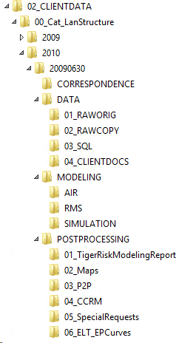
Analytics Drive: Client Data
Folder Template:
R:\02_CLIENTDATA\00_Cat_LanStructure
Copy / Paste it as a new directory in client folder
ALL client work MUST be saved in the client’s directory! NOT your working directory

Slide 6
Analytics Drive: Client Data
Optional / Save client emails here that contain project specific information.
RAWORIG
Original data from client gets saved here
Pristine copy
NO alterations to these files
Provides audit trail if there are questions of exactly what data was received from the client
RAWCOPY
Copy of original data
Make any alterations needed to get the data into SQL (e.g. headers)
SQL
Save your SQL scripts here.
CLIENTDOCS
Assumptions documents that are shared with the client

Slide 7
Analytics Drive: Client Data
AIR
Import files for AIR
RMS
Import Files for RMS
SIMULATION
Infrequently used
Custom loss file work

Slide 8
Analytics Drive: Client Data
TigerRiskModelingReport
Any exhibits or reports created for the client
EP summaries, TMRs, etc.
Maps
Save ArcMap work here
P2P/CCRM – Not Used
SpecialRequests
Data requests from the client (e.g. “Can you send me distance to coast by location?”, etc.)
ELT EPCurves
ELTs for import into TigerEye
Add directories for more complicated projects as needed. Also, if a placement is being worked on, create a directory for the data that goes to market (e.g. 07_toMarket).

Slide 9
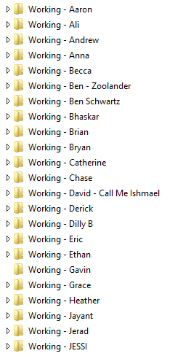
Analytics Drive: Working
Personal directory to save anything besides client work
Frequently used SQL scripts
Reference materials
Personal projects / learning
Etc.
ALL client work MUST be saved in the client’s directory! NOT your working directory

Slide 10
Naming Conventions
In general, a file names should follow a consistent naming pattern.
It can vary slightly by client but try to be consistent.
Examples:
EP Summary: Palomar_20210630_SCS_EP_Summary
SQL Database:
LHPIC_20210630_RawData
LHPIC_20210630_EDMv181
LHPIC_20210731_CEDEv8
Client_DataAsOf_OptionalDescription_FileTypeWithVersion

Slide 11


